Slide 1
Family enrollment meeting
January 7, 2025
Pleasant Valley Town Hall
Cleghorn

Slide 2
Shooting Sports Leadership Committee
Secretary: Jessica Zeman
Treasurer: Jessica Zeman
Vice President: Darren Schlewitz
President: Jon Dorn

Slide 3
Instructors
Archery | Rifle | Pistol | Shotgun
Greg Zeman Jessica Zeman Jim Stone Melissa Dimmitt Jeff Munion | Jon Dorn Darren Schlewitz Bryant Melsness | Jake Henning Jon Dorn | Darren Schlewitz Jon Dorn

Slide 4
New Leaders
Bryant Melsness & Jeff Munion
We are coordinating with Doug Thompson, WI State 4-H Shooting Sports Leader
Disciplines: Archery, Rifle/Air Rifle, Shotgun
Please begin by completing VIP 4-H Training (Volunteer In Preparation) - Contact Rachel Hart-Brinson for more info.
Let us know and Doug will organize the appropriate training. He’s flexible and wants to help!

Slide 5
4-H Shooting Sports
National program designed to teach shooting sports safety & marksmanship
More than 5000 youth and 400 volunteers statewide
Life skills development
Safe handling and responsible use of firearms and archery equipment
Developing technique and skills for target shooting
Lifelong hobbies, hunting and wildlife

Slide 6
Disciplines
Archery
Air Pistol (.177 cal)
Air Rifle (.177 cal)
Muzzleloader
Shotgun
.22 Pistol
.22 Rifle

Slide 7
Policies
Participants must be in the 3rd grade and at least 8 years old
Two certified instructors needed to run “the line”
At least one instructor needs to be certified in the discipline being practiced
Only 4-H certified leaders can assist on “the line”
Everyone is required to wear safety glasses
All equipment is provided
Personal equipment must be compliant and inspected by the instructor

Slide 8
Air Rifle Schedule
Tuesday Evenings (7 weeks) at Banbury Place Door # 17
Early Session – 5:45-6:40 pm
Late Session – 6:45-7:40 pm
January 14 February 11
January 21 February 18
January 28 February 25
February 4

Slide 9
Banbury Place

Slide 10
Ecology Schedule
March 4
5:45-6:40: Beaver Creek Reserve Earth Talk
6:45-7:40
Any Future Ideas?

Slide 11
Archery Schedule
Tuesday Evenings (7 weeks) at Banbury Place Door # 17
Early Session – 5:45-6:40 pm
Late Session – 6:45-7:40 pm
March 11 April 8
March 18 April 15
March 25 April 22
April 1

Slide 12
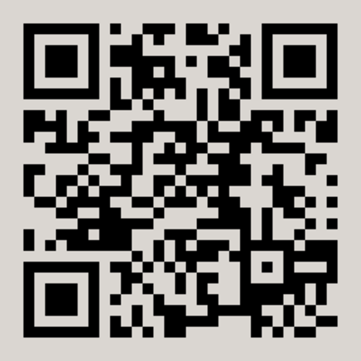
Competitive Shoot Opportunities
The Karl Petersen Invitational Shoot
Saturday, April 19, 2025
Augusta Area Sportsman Club
Students of all ability levels are encouraged to participate
Registration will be available on our website
Multiple shoots around the state
Check www.afkht.us/ecss/eau-claire-county-invitational or
https://4h.extension.wisc.edu/opportunities/projects/shooting-sports/
Equipment can be checked out
National Shoot: Grand Island, Nebraska, June 22-27, 2025

Slide 13
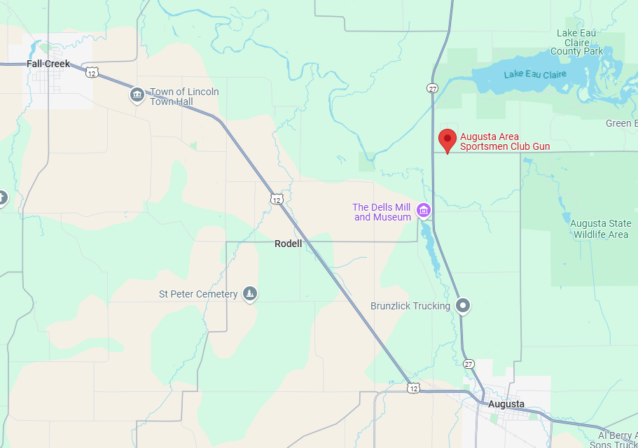

Slide 14
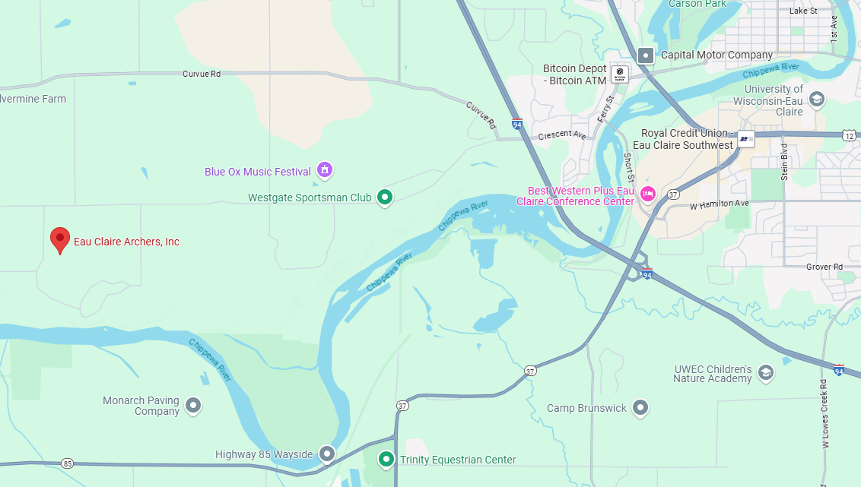
End of Year shoot/Picnic/Banquet
April 29 @ 5:30
Eau Claire Archers

Slide 15
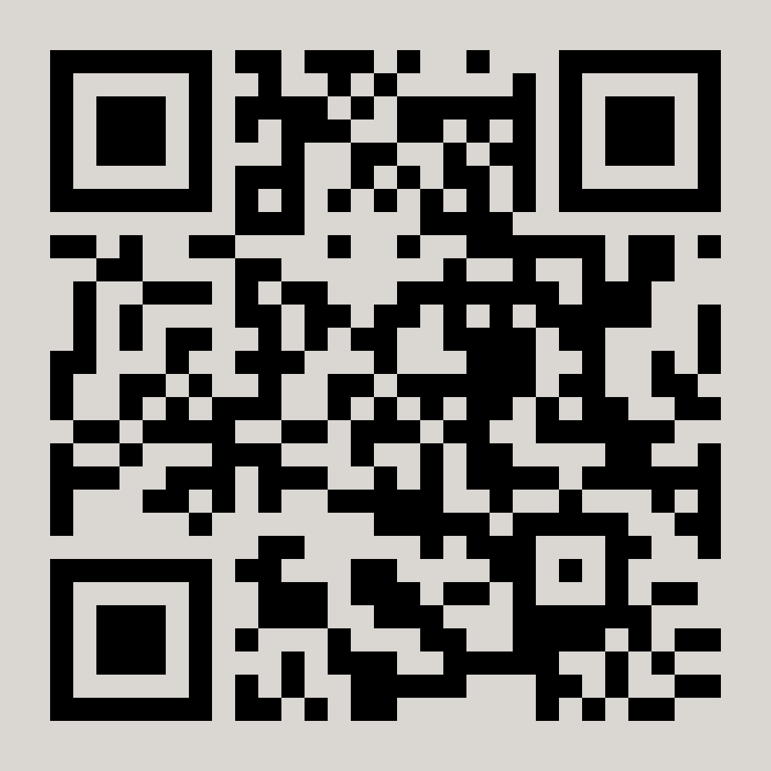
Communication System
Please follow our Facebook Page!!!
Eau Claire County 4-H Shooting Sports
We will use the Facebook page to communicate
practice cancellations due to weather conditions
All other communications will be in email form to
the addresses provided on registration forms

Slide 16
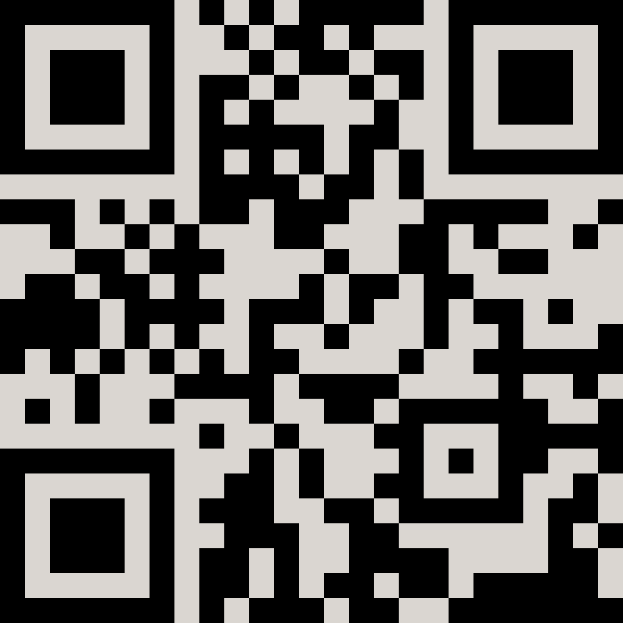
Eau Claire County Shooting Sports www.afkht.us/ecss

Slide 17
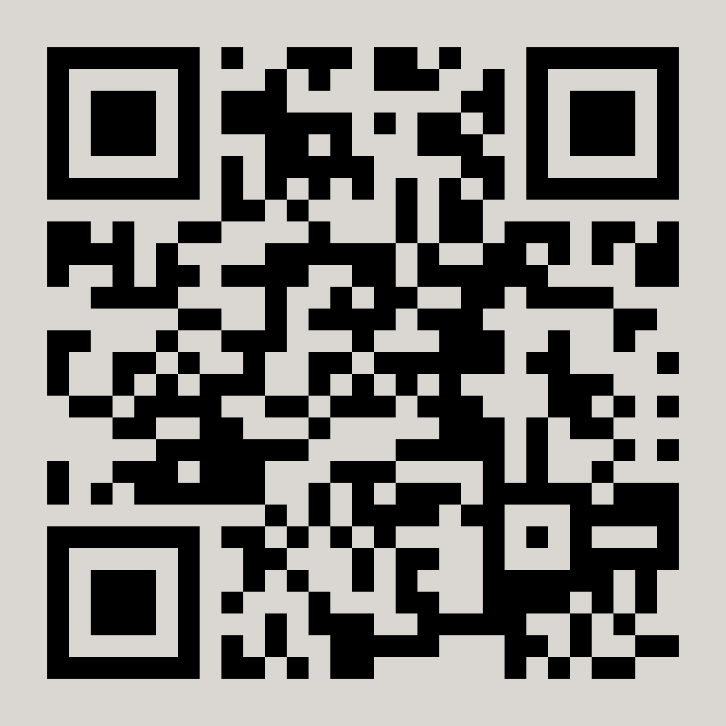
Registration
If you plan to participate in Shooting Sports, we need your help with three items:
A. Registration Packet
B. Pay Participation Fees (tonight or mail) $15/air rifle student
$15/archery student
C. Submit Volunteer Fee
$50 check
Cashed/Returned in August
D. Registration can also be done on our website

Slide 18
$50 Volunteer Fee
The Karl Petersen Invitational Shoot – Saturday, April 19
Buffalo County Fair – Saturday, August 2?????
May need assistance during practice sessions

Slide 19
Make sure we have your email address!
You will receive an email from us tonight or tomorrow with 3 items:
Registration packet
A copy of this PowerPoint to reference contact information and dates
A fee reminder with Jessica Zeman’s address

Slide 20
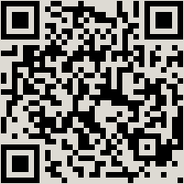
Apparel Orders
Place your orders
Lots of different clothing options
Clothing will be delivered on March 4
Chippewa Valley Sporting Goods
https://cvsports.chipply.com/ecshooting2025

Slide 21
Equipment
Need to update and replace some equipment
Thank You Jessica Zeman
WI DNR Hunter R3 (Recruitment, Retention and Reactivation) Grant
The NRA Foundation Grant

Slide 22
Thank You to our Partners

Slide 23
Thank you for making the 4H Shooting Sports project a success in EC County!
Jon Dorn (Air Rifle Lead Instructor)
jon@dornconstructionllc.com or 715-577-6605
Greg Zeman (Archery Lead Instructor)
jzeman@charter.net or 715-577-0149

Slide 24
Thank You!!!

Slide 25
Registration Apparel

Slide 26
KEEP???? DNR Guest Speakers This is one of our project’s goals this year!
The EC Shooting Sports program is more than just an opportunity for students to gain knowledge and hands-on instruction in air rifle and archery. There is also an opportunity to learn about Wisconsin natural resources.
February 28 – Mr. Terry Shaurette, DNR Biologist
March 7 – Mr. Jacob Bolks & Mr. Ryan Lowry, DNR Wardens

Slide 27
Shooting Sports Logo Design

